Slide 1

Formal Models in OOP
Presented by:
Elizer Ponio Jr.

Slide 2
Outline
Unified Modeling Language
UML Class Diagram
Formal Specification Languages

Slide 3
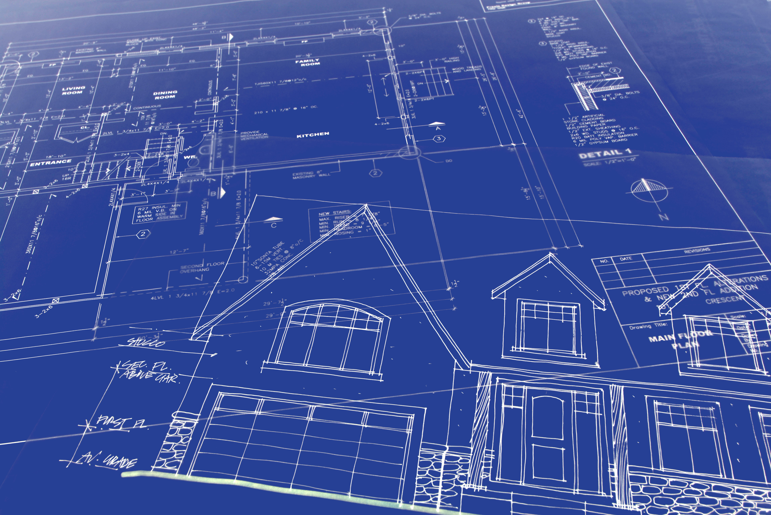

Unified Modeling Language
Unified Modeling Language (UML) is a general purpose modelling language that is used to visualize the way a system has been designed.
It is similar to blueprints used in other fields of engineering.
UML is not a programming language, it is a visual language.

Slide 4

Do we really need UML?
Complex applications need collaboration and planning from multiple teams and hence require a clear and concise way to communicate amongst them.
Businessmen do not understand code. UML becomes essential to communicate with non-programmers the essential requirements, functionalities and processes of the system.

Slide 5

Do we really need UML?
A lot of time is saved down the line when teams can visualize processes, user interactions and static structure of the system.
UML is linked with object-oriented design and analysis. UML makes the use of elements and forms associations between them to form diagrams.

Slide 6
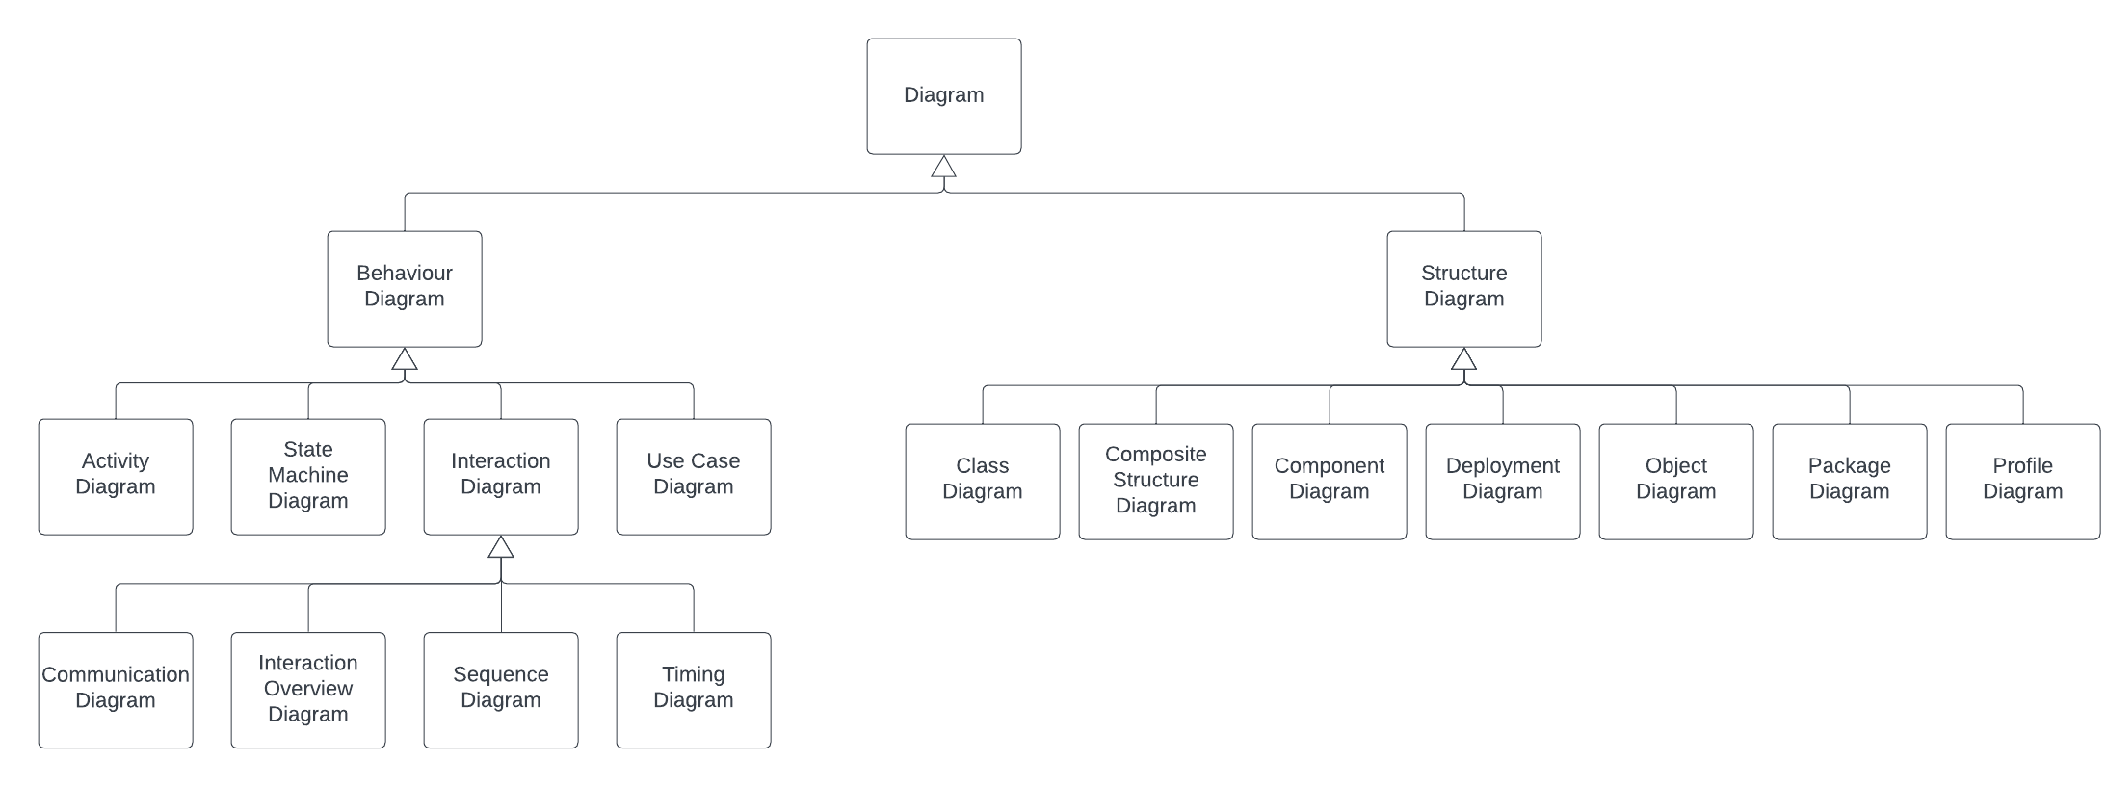

Slide 7
Outline
Unified Modeling Language
UML Class Diagram
Formal Specification Languages

Slide 8
Class Diagram
Class diagrams are one of the most useful types of diagrams in UML as they clearly map out the structure of a particular system by modeling its classes, attributes, operations, and relationships between objects.
Popular among software engineers to document software architecture, class diagrams are a type of structure diagram because they describe what must be present in the system being modeled

Slide 9
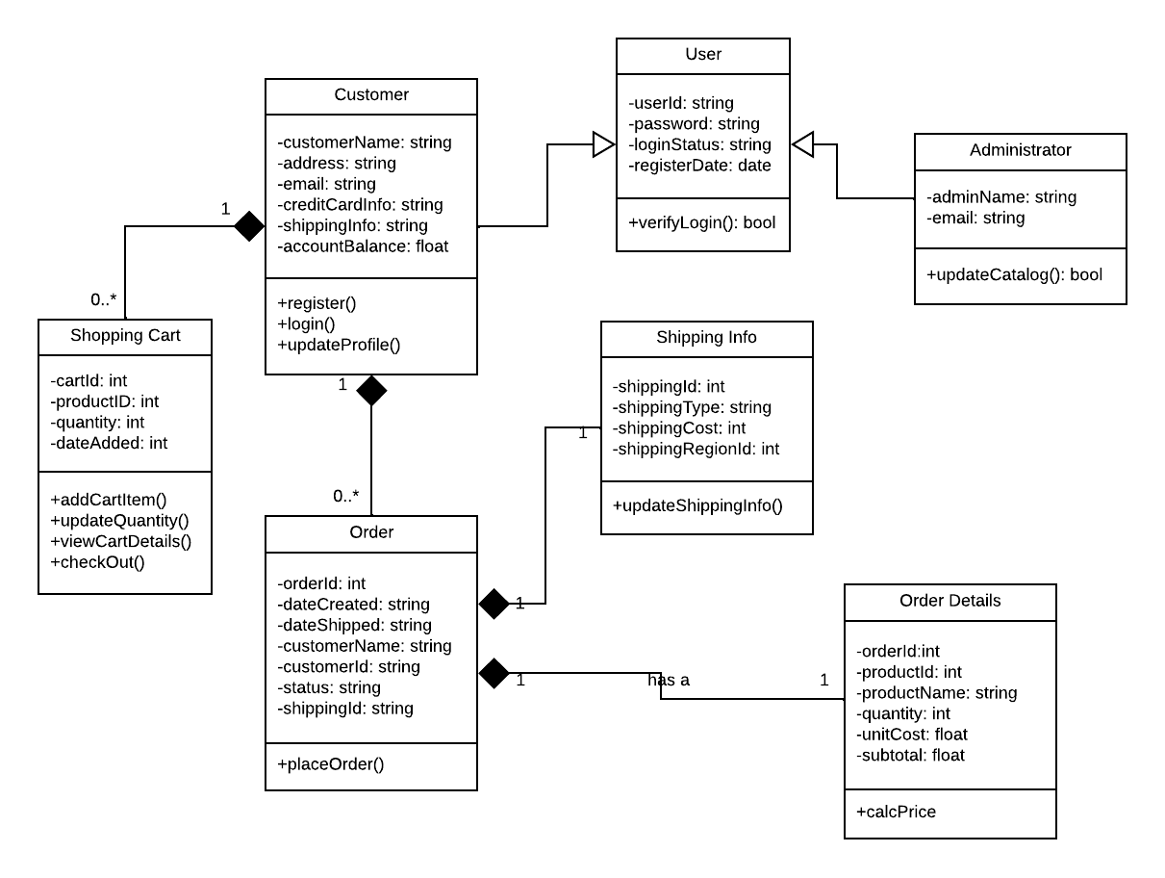

Slide 10
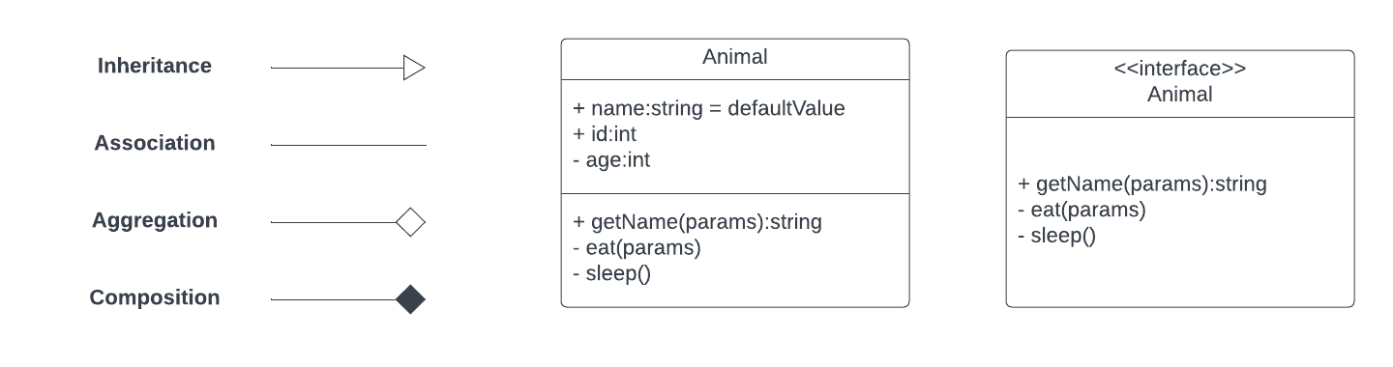

Slide 11
Outline
Unified Modeling Language
UML Class Diagram
Formal Specification Languages

